Slide 1

Game Genre Analysis & Prediction
Team 12
Ishan Subodh Joshi
Kunal Singh Pundir

Slide 2

“My Parents said that sitting at home playing video games won't take you anywhere in life” - PewDiePie

Slide 3
Problem Statement
Navigating Steam's extensive game library is challenging due to the sheer number of options. Traditional recommendation systems often provide generic suggestions that don't reflect individual tastes.
To address this, an advanced, AI and machine learning-based approach is suggested. This system would analyze player data, including past purchases, playtimes, reviews, and social interactions, to understand individual preferences.
By doing so, it can recommend games that align more closely with each user's interests, enhancing their gaming experience.
This approach not only saves time in searching for games but also leads to higher player engagement and satisfaction, fostering a more dynamic and engaging gaming community.

Slide 4

Goal
Unleashing the Power of Data Science to Revolutionize User Experience in the Booming Gaming Industry
The gaming industry is experiencing an extraordinary surge, with new players joining every day.
However, navigating the vast universe of games can be overwhelming, leaving users struggling to discover titles that truly captivate their interests.
This presents a significant opportunity for data science to step in and revolutionize the gaming experience.

Slide 5

Impact
Benefits of a Data Science-Driven Approach:
Enhanced user engagement: Players spend less time searching and more time enjoying games they love, leading to increased satisfaction and loyalty.
Increased game sales: Developers reach new audiences and attract players who might have otherwise overlooked their titles.
Improved game design: Data-driven insights inform game development, leading to experiences that are more engaging and fulfilling for players.
Boosted innovation: Data science fuels the creation of new and innovative features that further enhance the gaming experience.

Slide 6





Let’s Dig Deeper!!!
DATA CLEANING AND PREPROCESSING
EXPLORATORY DATA ANALYSIS (EDA)
DATA SPLITTING
MODEL SELECTION AND EVALUATION

Slide 7
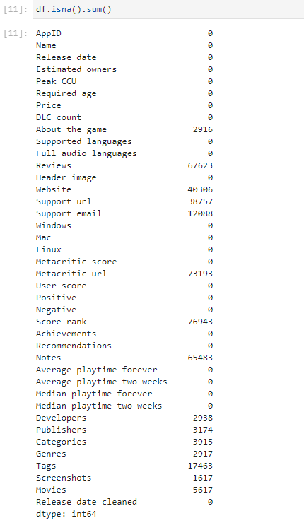
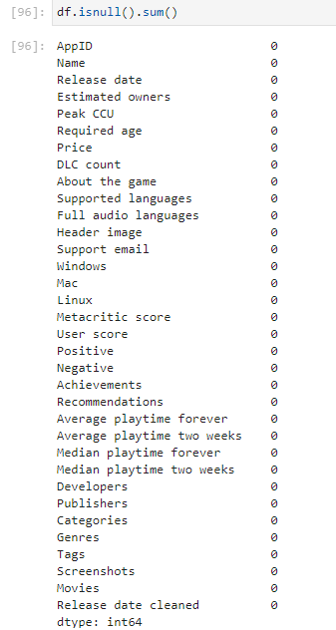
Data Cleaning
Before Cleaning
After Cleaning
‹#›

Slide 8
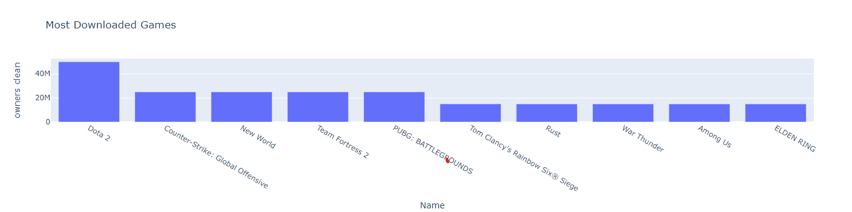
Exploratory Data Analysis
The bar chart illustrates the ownership of various popular video games, with "Dota 2" leading significantly at over 40 million downloads. The chart shows a descending order of game popularity, ending with "Among Us" and "ELDEN RING," which have the fewest downloads, indicating a potential variance in release dates or player base sizes.

Slide 9
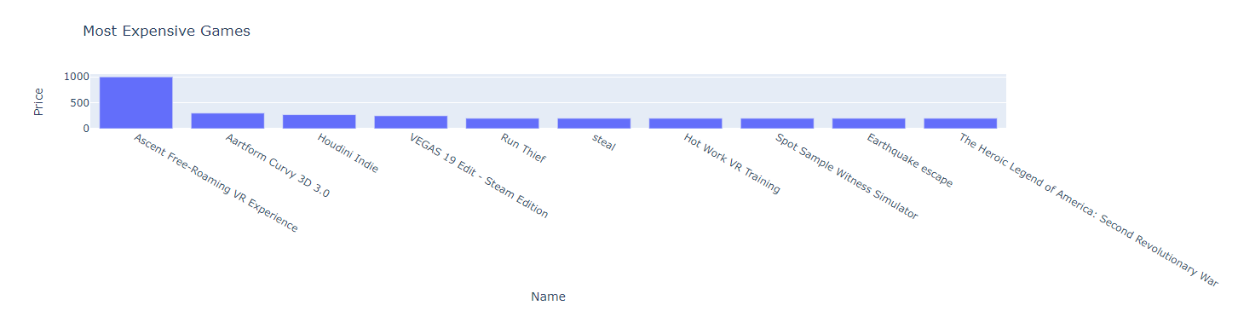
Exploratory Data Analysis
The bar chart depicts the "Most Expensive Games," with prices on the y-axis. "Ascent: Free-Roaming VR Experience" stands out as the costliest at $1,000, followed by a series of games priced significantly lower, such as "Artform Curvy 3D" and "Houdini Indie."
The prices show a steep drop from the most expensive title to the others, indicating a substantial price gap in the gaming market.

Slide 10
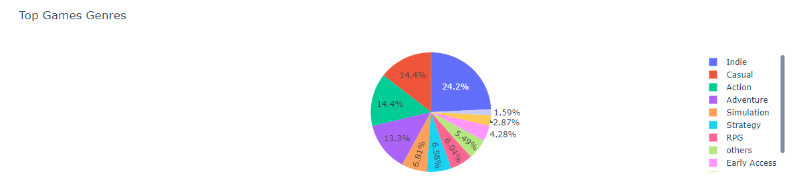
Exploratory Data Analysis
Above pie chart that represents the distribution of top game genres. The chart shows that the largest segment is for Indie games, making up 24.2% of the total. This is followed by Casual and Action games, each comprising 14.4%, and Adventure games at 13.3%. The other listed genres include Simulation, Strategy, RPG, others, and Early Access, with their respective shares of the total.

Slide 11
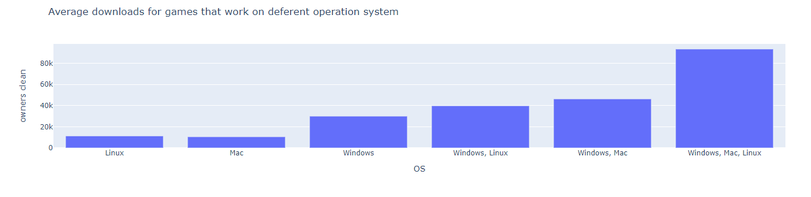
Exploratory Data Analysis
The graph shows the average number of drivers that work for different operating systems. Windows has the highest number of drivers, followed by Linux and macOS. Windows, Linux, and macOS have the highest number of drivers in combination.

Slide 12
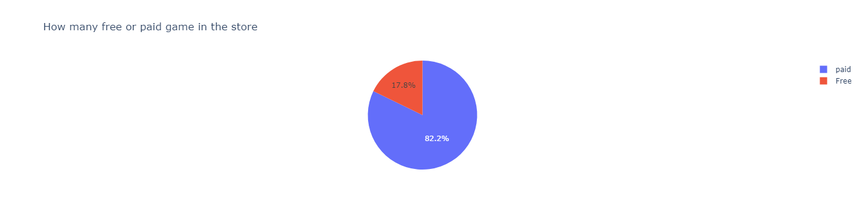
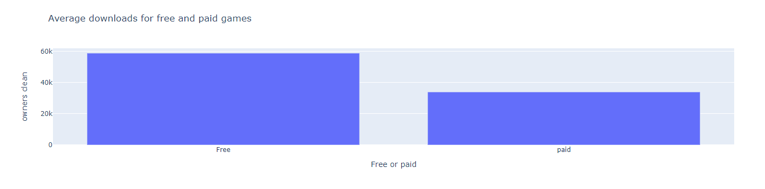
Exploratory Data Analysis
The pie chart indicates that in the game store, 82.2% of the games are free, while 17.8% are paid games. This highlights a majority preference or availability for free games in the store's offerings.
The bar chart compares average downloads for free and paid games, showing that free games have a higher average download count, around 50,000, while paid games have a lower average, roughly half that number. This suggests that free games are more popular in terms of download volume than paid games.
‹#›

Slide 13
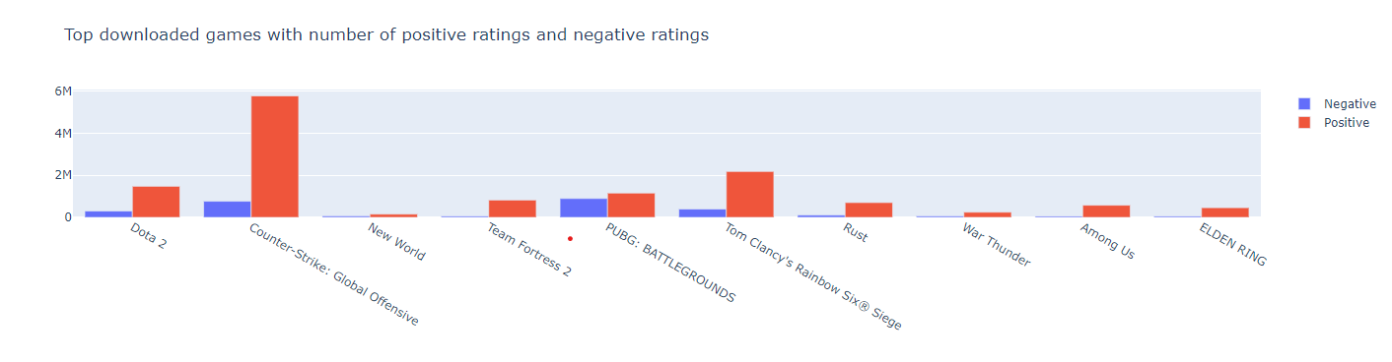
Exploratory Data Analysis
The graph shows the average number of drivers that work for different operating systems. Windows has the highest number of drivers, followed by Linux and macOS. Windows, Linux, and macOS have the highest number of drivers in combination.
The graph also shows that the number of drivers for each operating system has increased over time.

Slide 14
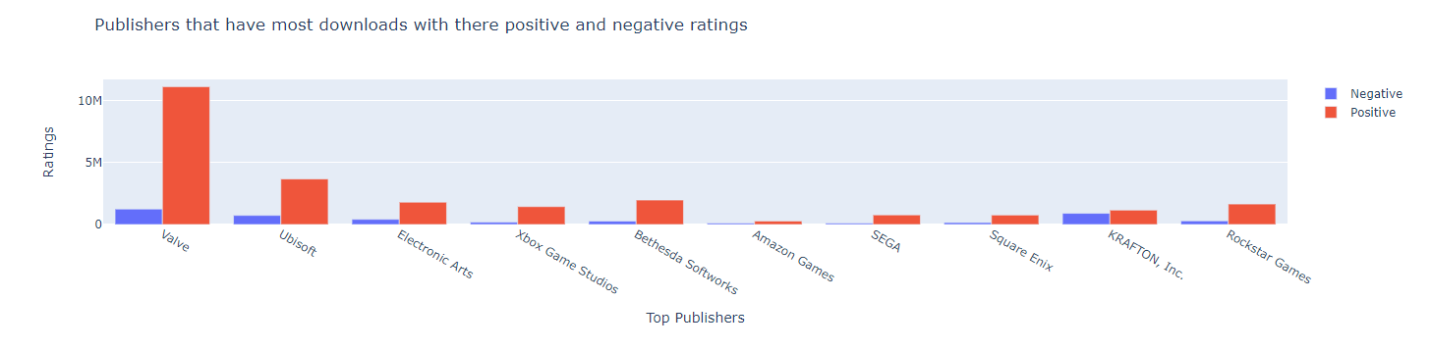
Exploratory Data Analysis
The graph shows the number of publishers that have most downloads with their positive and negative ratings. The top publishers are Rockstar Games, KRAFTON, INC, Square Enix, SEGA, and Amazon Games.

Slide 15
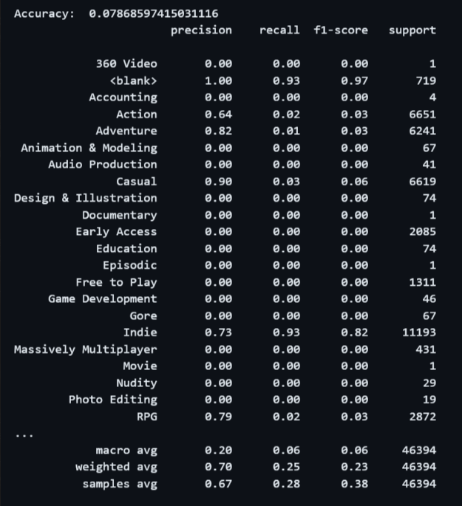
Data Pre-Processing
When we first ran our model without preprocessing it gave us the accuracy of approximately 0.08%
After Preprocessing we were able to achieve the accuracy of approximately 78.7%

Slide 16
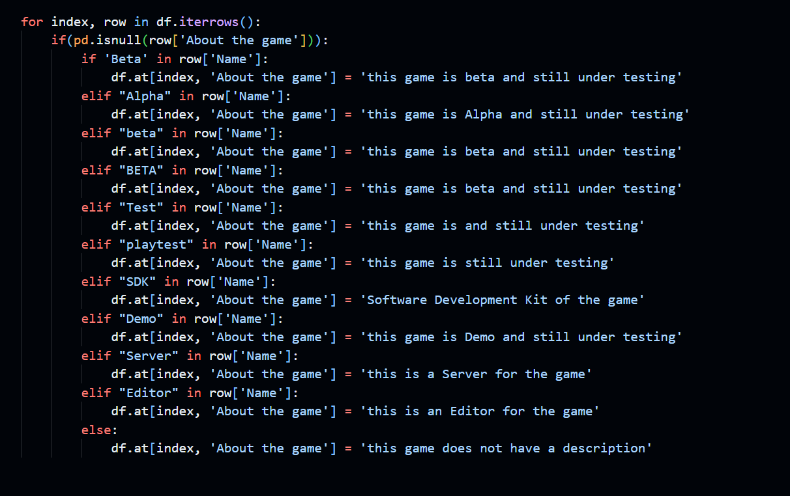
Data Pre-Processing
This code shows how to fill in missing game descriptions in a dataset of games that are in beta or testing.
The code first checks if the game name contains any of the following keywords: "Beta", "Alpha", "Test", "playtest", "SDK", "Demo", "Server", or "Editor".
If the game name contains one of these keywords, the code fills in the description with a generic description that is based on the keyword.
For example, if the game name contains "Beta", the code fills in the description with "This game is in beta and still under testing."
If the game name does not contain any of the keywords, the code fills in the description with "This game does not have a description."

Slide 17
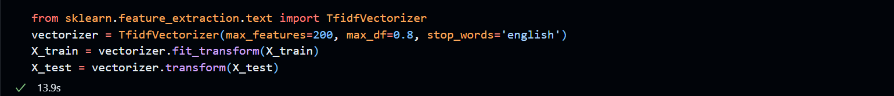
Data Pre-Processing
TF-IDF (Term Frequency-Inverse Document Frequency) to convert text into numerical vectors.
TF-IDF weights words based on their local frequency (in text) and global rarity (in dataset)

Slide 18
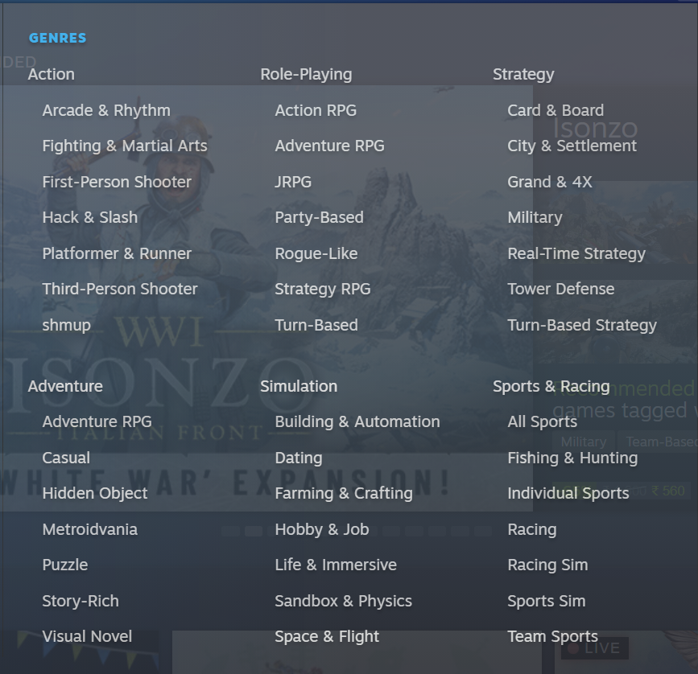
Data Pre-Processing
Steam has 6 main genres.

Slide 19
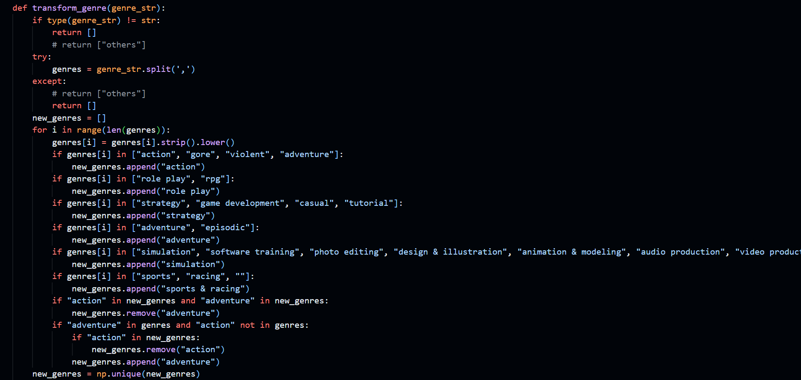
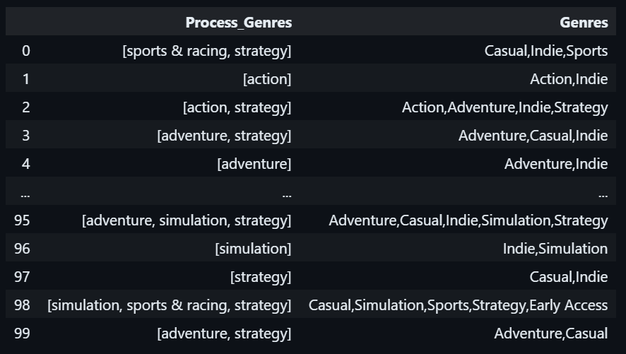
Data Pre-Processing
Transformed 33 genre categories into 6 main categories.

Slide 20
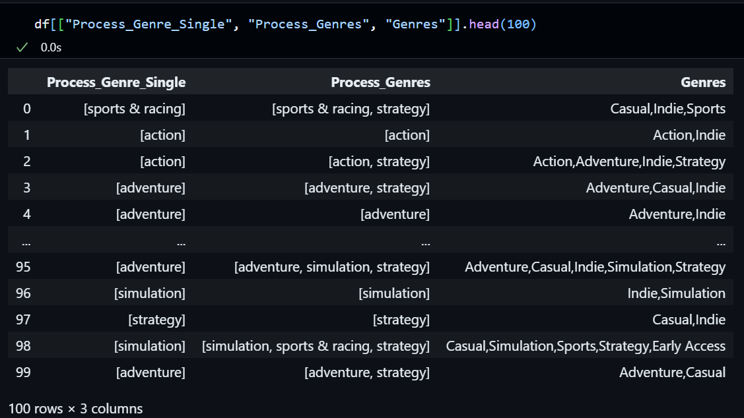
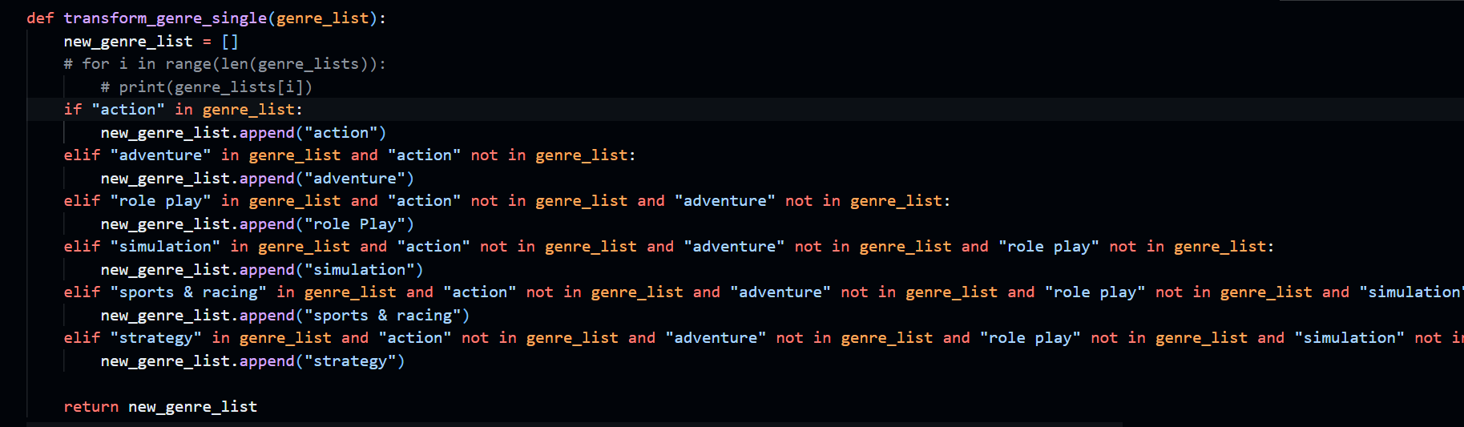
Data Pre-Processing
Transformed multioutput classification to single output multiclassification.
Convert 6 main genres into 4 Core genres category:
Action
Adventure
Sports & Racing
Strategy
Performed One-hot encoding for genres

Slide 21
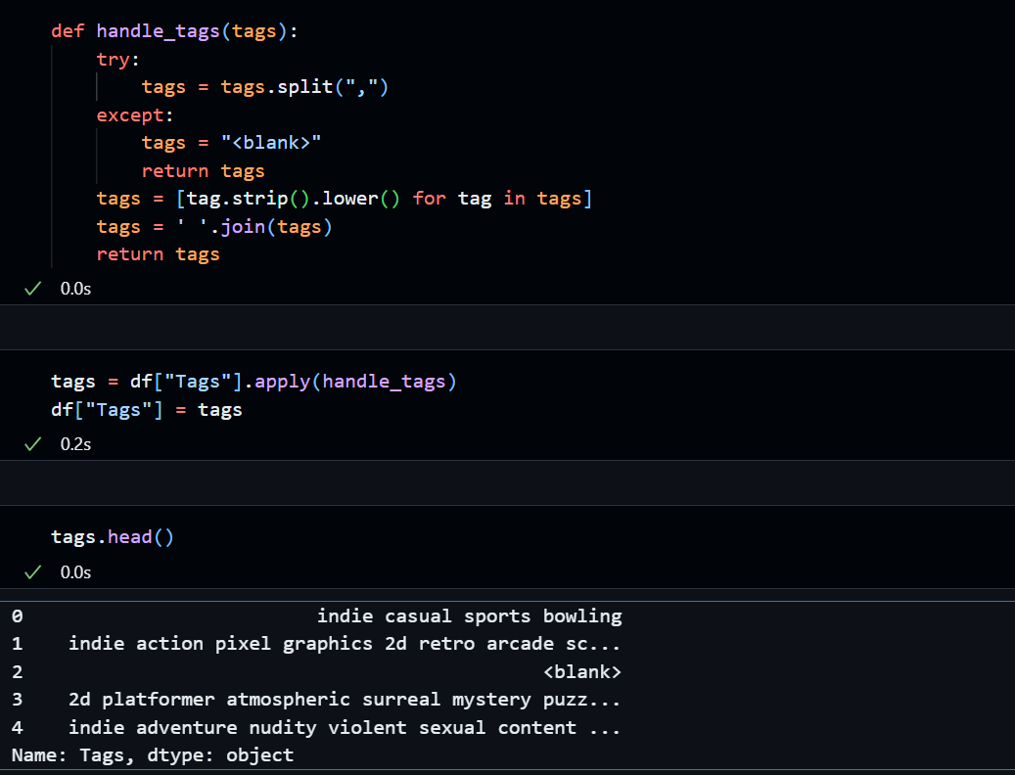
Data Pre-Processing
Transformed the comma separated tags string values for pre-processing.

Slide 22
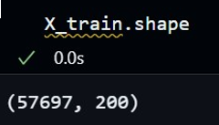
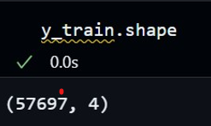
Data Splitting
The image shows a code snippet for performing a train-test split in Python. The training set will contain 80% of the data, while the test set will contain 20% of the data. This split is used to evaluate the performance of machine learning algorithms on unseen data.
‹#›

Slide 23

Model Selection
K- Nearest Neighbor
Random Forest
One vs Rest (Logistic Regression)
Gradient Boosting
Cat Boost
In summary, the choice of algorithm depends on the underlying data relationships in a specific problem. Random Forest and Gradient Boosting showcase versatility, effectively handling complex patterns, making them suitable for various tasks.
KNN excels in identifying local structures and clusters. Cat Boost, similar to Random Forest and Gradient Boosting, is adept at managing intricate patterns and is particularly known for its robust handling of categorical features.
On the other hand, One vs Rest Logistic Regression is a simpler option, well-suited for straightforward classification problems where interpretability is essential. When selecting the most appropriate algorithm, it's vital to consider your data's characteristics and the objectives of your analysis.

Slide 24

K-Nearest Neighbor
Strengths:
Simple and intuitive.
Effective at capturing local patterns and clusters.
Non-parametric, making it versatile for various data types.
Applications:
Ideal for tasks with well-defined clusters or neighborhoods.
Works well when data has a clear spatial or proximity-based structure.

Slide 25
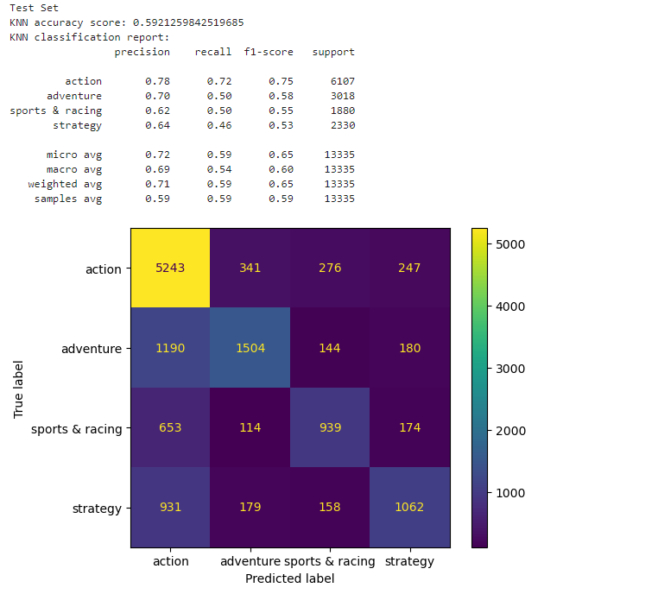
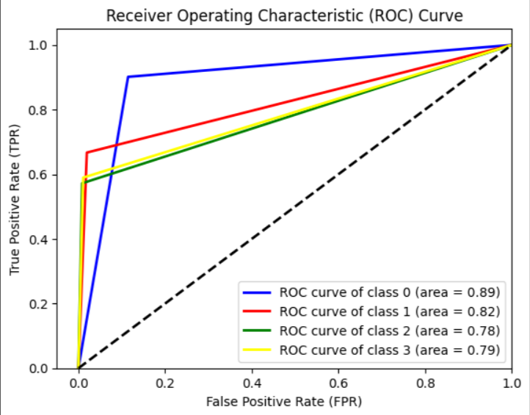
K-Nearest Neighbor

Slide 26

Random Forest
Strengths:
Effective at capturing complex relationships in the data.
Robust against overfitting.
Suitable for both classification and regression tasks.
Can handle many features.
Applications:
Used when high predictive accuracy is needed.
Suitable for tasks with complex, non-linear data relationships.
Useful for feature importance analysis.

Slide 27
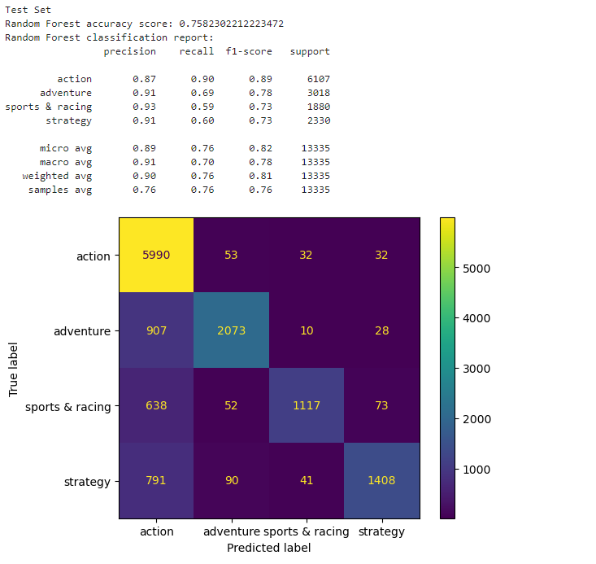
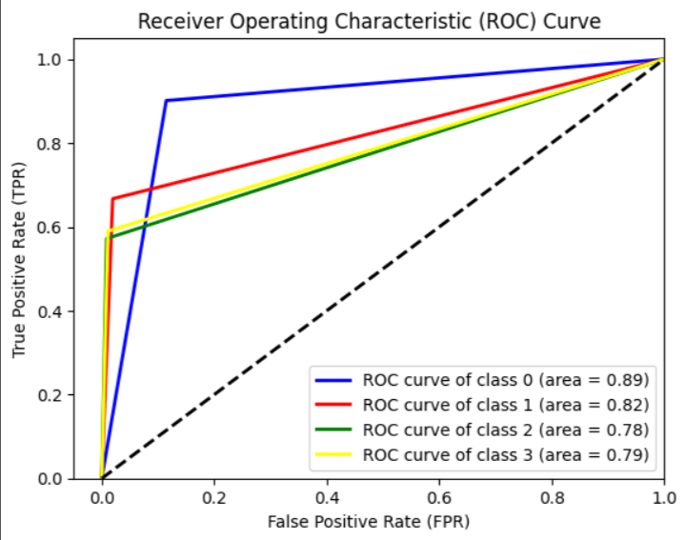
Random Forest

Slide 28


One vs Rest (Logistic Regression)
Strengths:
Applications:
Simple and interpretable.
Effective for linearly separable classes.
Useful for multi-class classification problems.
Appropriate when the relationships between classes are relatively simple.
Suitable for cases where interpretability is crucial.

Slide 29
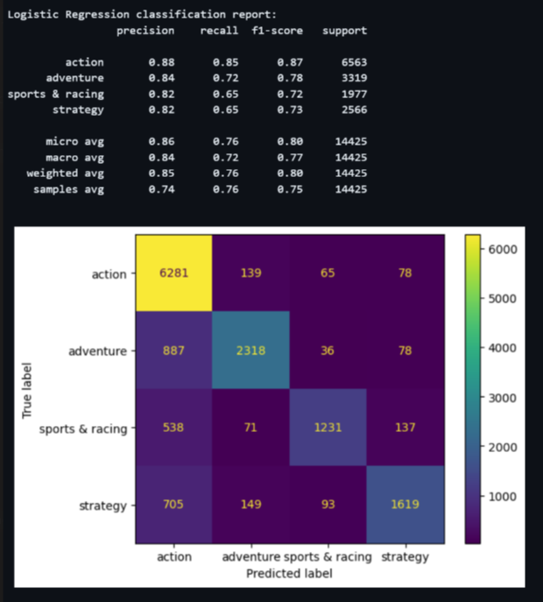
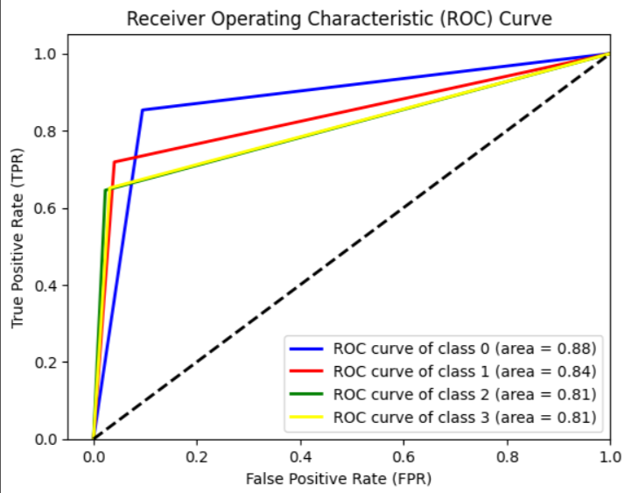
One vs Rest (Logistic Regression)

Slide 30

Gradient Boosting
Strengths:
Highly effective at capturing complex relationships.
Can model non-linear patterns.
Combines the strength of multiple models to improve accuracy.
Applications:
Used for tasks where high accuracy is paramount.
Suitable for a wide range of classification and regression problems.
Works well with complex, non-linear data relationships.

Slide 31
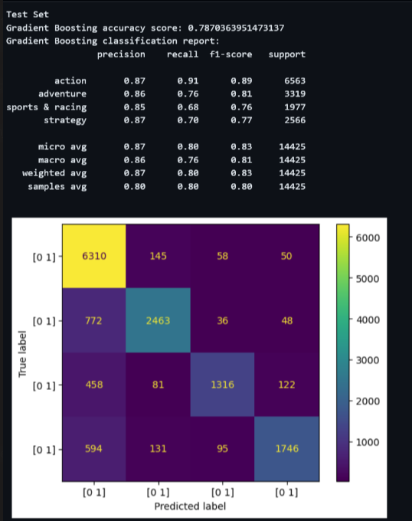
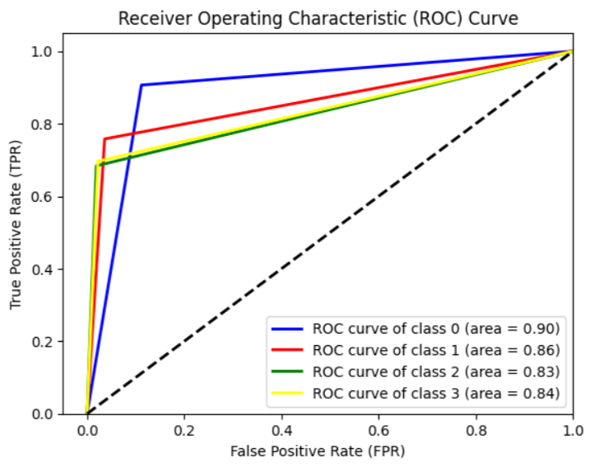
Gradient Boosting

Slide 32


Cat Boost Classifier
Strengths:
Applications:
Efficient Handling of Categorical Features
Robustness Against Overfitting.
Automatic Hyperparameter Tuning.
High Predictive Performance
Classification and Regression
Recommendation Systems
Natural Language Processing (NLP)

Slide 33
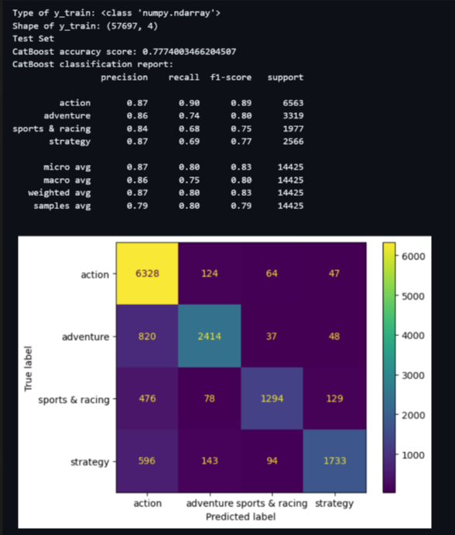
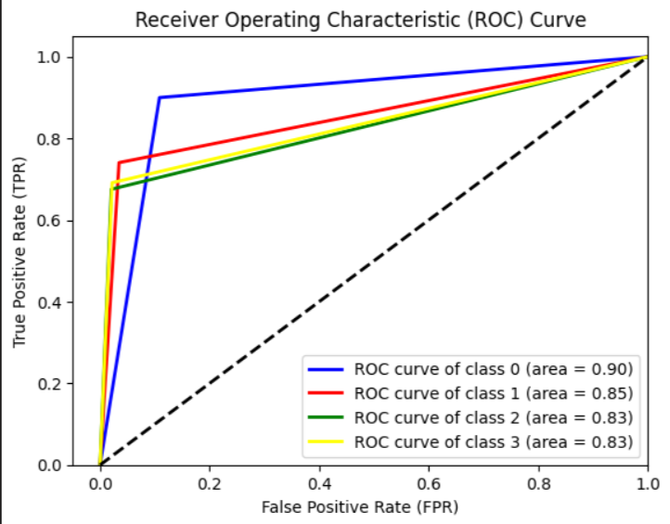
Cat Boost Classifier

Slide 34

Thank You!!!

